Slide 2



First, we will use a place value chart and counters to complete the addition calculation.
426 + 143 =
H | T | O

Slide 3
We need to find the total value for each column. We always start
with the place value column of the smallest value. In this example,
it is the ones column.
569
426 + 143 =
H | T | O
500
60
9

Slide 4
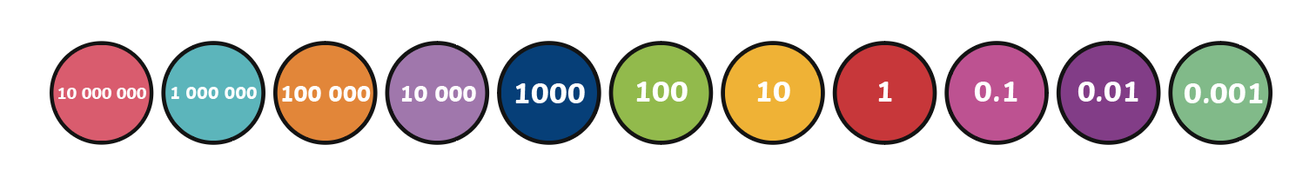
Now, we will use the same method to answer a different addition calculation.
864
712 + 152 =
H | T | O
800
60
4

Slide 5
Again, we will use the same method to answer a different addition calculation.
687
357 + 330 =
H | T | O
600
80
7

Slide 6
Now, we will use the written method of column addition to solve a different addition calculation.
668
416 + 252 =
 | H | T | O
 | 4 | 1 | 6
+ | 2 | 5 | 2
6 ones + 2 ones
= 8 ones
1 ten + 5 tens
= 6 tens
4 hundreds + 2 hundreds
= 6 hundreds
6
6
8

Slide 7
Can you use the written method of column addition to solve these two different addition calculations?
825 + 154 =
979
642 + 234 =
876
 | H | T | O
 | 8 | 2 | 5
+ | 1 | 5 | 4
 | H | T | O
 | 6 | 4 | 2
+ | 2 | 3 | 4
9
7
9
8
7
6

Slide 8
Now, we are going to look at addition calculations that involve regrouping. First, we will use a place value chart and counters to complete an addition calculation.
578 + 146 =
8 ones + 6 ones = 14 ones
We need to regroup 10 ones into 1 ten.
We put the regrouped ten into the tens column.
This leaves us with 4 ones in the ones column.
H | T | O
4

Slide 9
578 + 146 =
7 tens + 4 tens + 1 ten = 12 tens
We need to regroup 10 tens into 1 hundred.
We put the regrouped hundred into the hundreds column.
This leaves us with 2 tens (20) in the tens column.
H | T | O
20
4

Slide 10
724
578 + 146 =
H | T | O
5 hundreds + 1 hundred + 1 hundred = 7 hundreds
700
20
4

Slide 11
Can you use the same method to answer this addition calculation with regrouping?
465 + 348 =
H | T | O

Slide 12
813
465 + 348 =
H | T | O
800
10
3

Slide 13
Now, we will use the written method of column addition to solve an addition calculation with regrouping.
781
498 + 283 =
 | H | T | O
 | 4 | 9 | 8
+ | 2 | 8 | 3
8 ones + 3 ones = 11 ones so we need to regroup.
9 tens + 8 tens + 1 ten = 18 tens so we need to regroup.
4 hundreds + 2 hundreds
+ 1 hundred = 7 hundreds
7
8
1
1
1

Slide 14
Can you use the written method of column addition to solve these two addition calculations with regrouping?
575 + 267 =
842
255 + 635 =
890
 | H | T | O
 | 5 | 7 | 5
+ | 2 | 6 | 7
 | H | T | O
 | 2 | 5 | 5
+ | 6 | 3 | 5
8
4
2
8
9
0
1
1
1

